Slide 2

In need of a print ?

Slide 3

Last minute printouts to be taken?

Slide 4
Need prints for urgent meetings ?

Slide 5

Prints for project submissions ?

Slide 6

Chasing deadlines ?

Slide 7

No time to stand in long queues for printouts ?

Slide 8
No time to stand in long queues for printouts ?

Slide 9

You are at the right place!

Slide 10
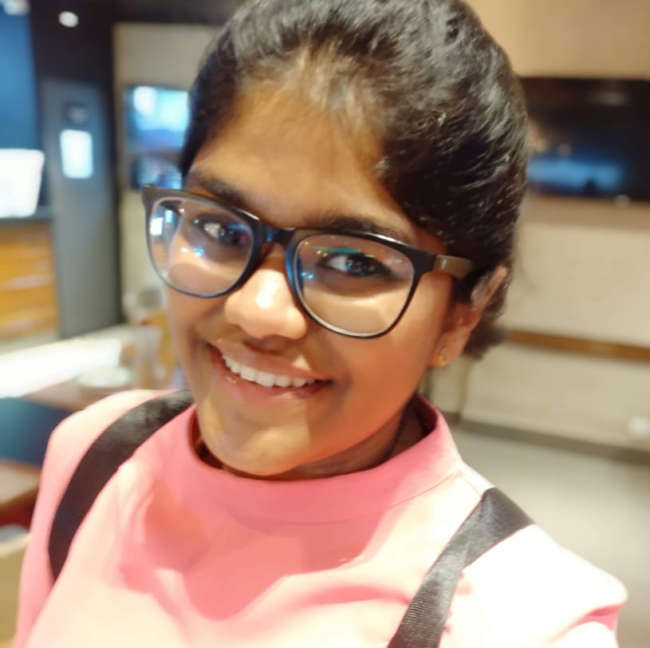
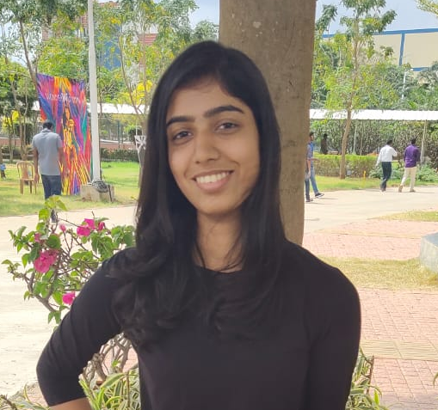
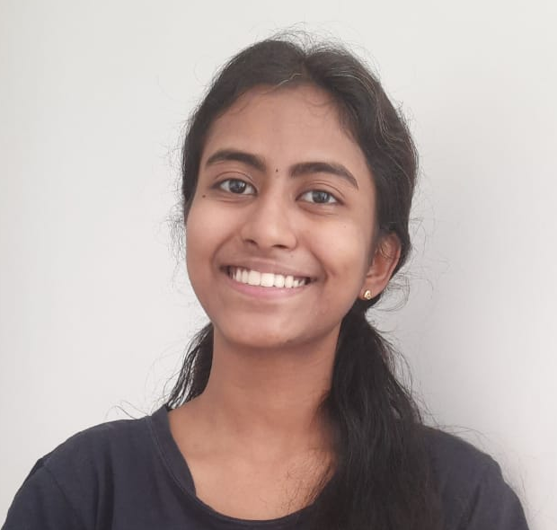
Anthra Devarajan
Loura Shiny
Prayasi Gopi

